Slide 1

Geographical Statistics of Engineering Internships
CYLIA Berkane
Fagnuo CAI
GUSTAVO Fleury
INDUraj PR
Quoc VIET Pham
Yen Chu Chen - JANET
June / 2019
Notes:
As próximas visitas serão compostas por 2 consultores;

Slide 2
AGENDA
1
3
Future Evolution/Conclusion
2
The Project
Technical Solutions
Management Solutions
4
5
Machine Learn Solutions

Slide 3
The Project – User Requirements
Resume of Introduction Document: Requirements, premises, etc.

Slide 4


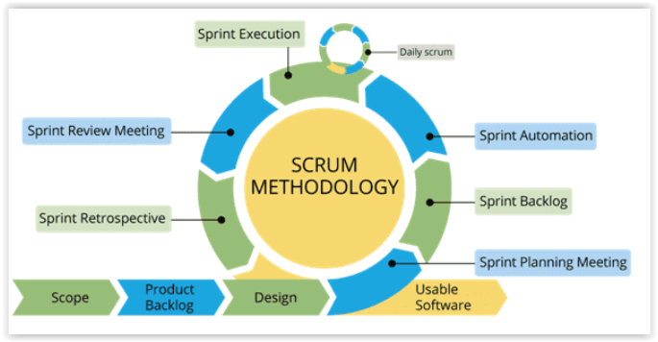
Management Solution - SCRUM
Notes:
-

Slide 5
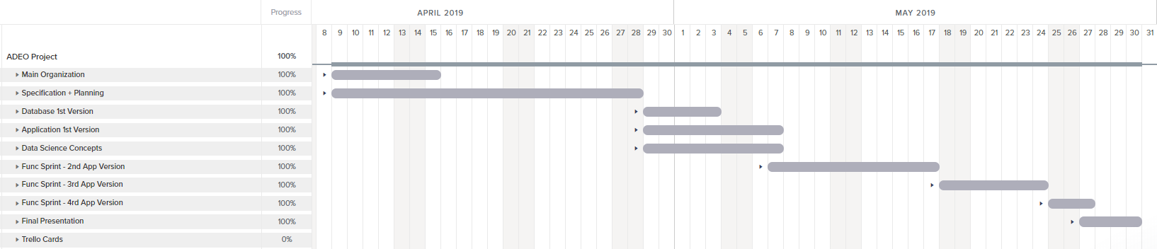
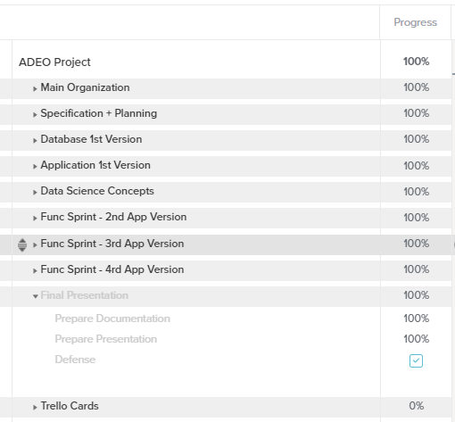
Management Solution - TeamGantt

Slide 6
Team Tasks Division
Infrastructure
Data Analysis / Statistics
Visualization / Documentation
Viet
Gustavo
Cai
Indu
Janet
Cylia
MANAGEMENT
Gustavo / Indu / Viet

Slide 7





Management Solutions
Backlog
Sync Problems

Slide 8
Technical Solutions
XXXX Explain the technologies used and why:
Python: (some libraries: pandas, sktlearn, fusion)
Django;
Chart.js;
Main dificulties:

Slide 9
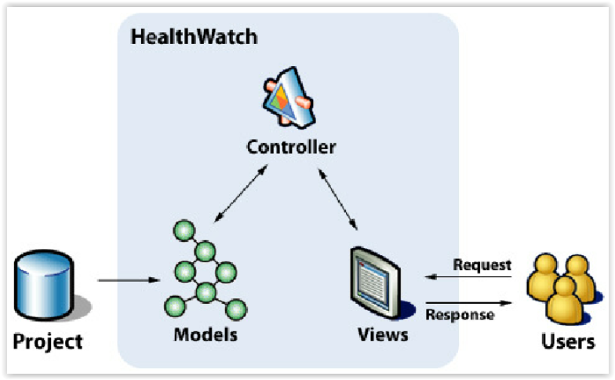
Technical Solutions - MVC

Slide 10

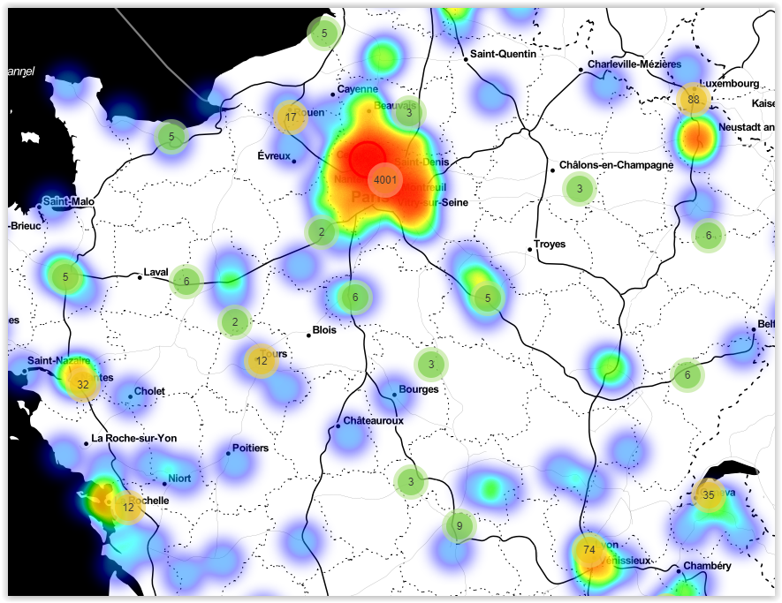





Technical Solutions – FINAL
Chart.js
Folium
Framework
Python
Anaconda
ETL
Database

Slide 11

Machine Learn Solutions - ETL
PRG_STUDENT
_SITE
ADR_STUDENTS
STUDENT
_INTERNSHIP
Database
Merged Table

Slide 12

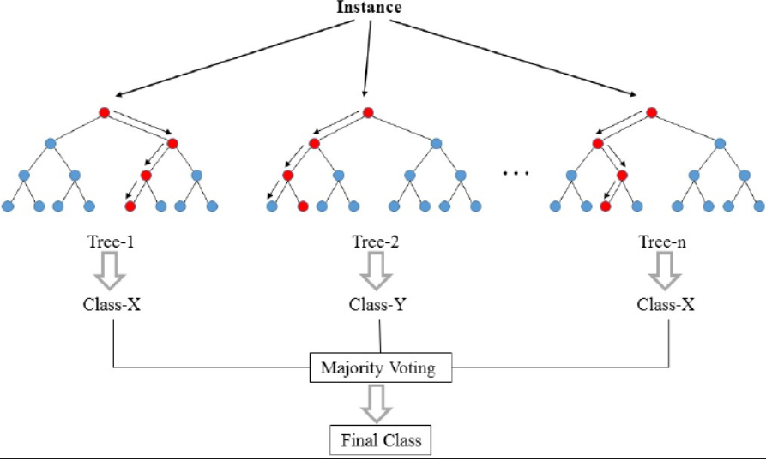
Random Forest
Remuneration
Source: https://fr.wikipedia.org/wiki/For%C3%AAt_d%27arbres_d%C3%A9cisionnels

Slide 13

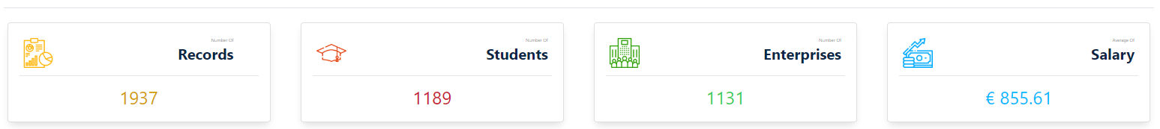

Random Forest - Comparative
+ 15% Data

Slide 14
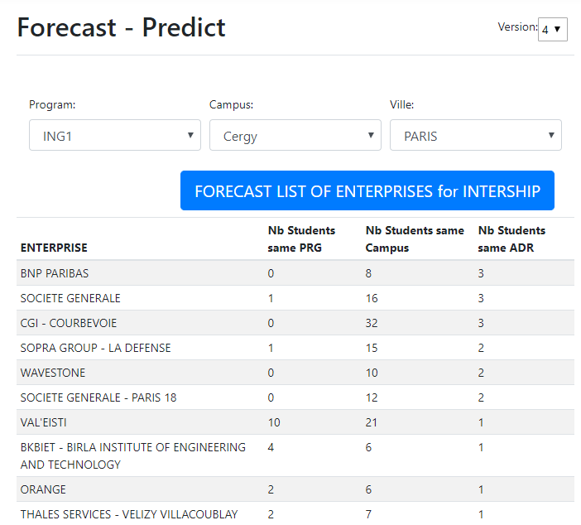
Intership Predict

Slide 15
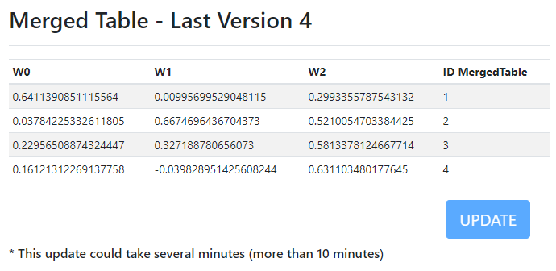
Intership Predict - Algorithm
XXXX - Explain

Slide 16
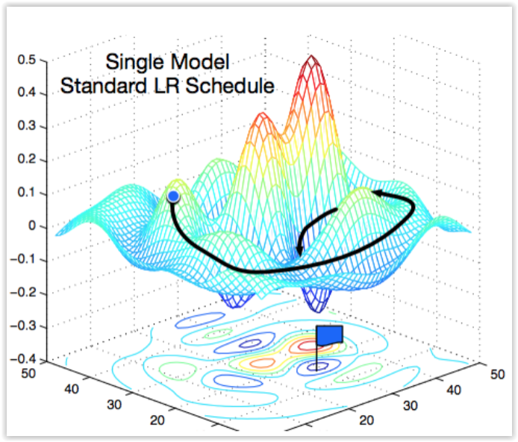
Gradient Descent
Source: https://medium.com/38th-street-studios/exploring-stochastic-gradient-descent-with-restarts-sgdr-fa206c38a74e

Slide 17
Intership Predict – Performance Problem
Weight Calculations
Tables Transformations
Acceptable Response Time
> 10 minutes
> 55 seconds
<10 seconds
< 0.2 seconds
Register Values/Table in Database
Team Work

Slide 18

Address
VILLE, CODE_POSTAL, PAYS
Performance
GMaps API
MergedTable
Register LAT / LON in Database

Slide 19
The System – Live Presentation
XXXX Slides for MAIN Funcionalites:
Login;
Insert Data;
ETL
....

Slide 20
Future Evolutions
Uniform graph interfaces;
Aditional graphs;
Export reports (Ex: PDF);

Slide 21
Conclusions
XXXXX

Slide 22
Thank you!
Questions?

